Slide 1

Radhe Institute of Engineering & Technology
Upleta
Final Year Project
Presented By :
Chudasama Yash R. (169700307006)
Guided By :
Rojiwadiya Anurag Sir (HOD)

Slide 2
Index
Introduction
Past Work
Methodology
Technology
Main Modules
Activity Diagram
Use Case Diagram
E-R Diagram
Data Flow Diagram
Screenshots
Conclusion
References

Slide 3
Introduction
SmartCalc is an android application which allows you to solve the mathematical problems using phone camera.
To solve the mathematical problem, take photo of your mathematical problem and then SmartCalc will give you the answer.
Using SmartCalc, solving mathematical problems become very easy.
SmartCalc can solve arithmetic equations, logarithm, linear equations.
In addition, user can edit expression captured by android device and see the result of that expression.

Slide 4
Past Work
Group Discussion.
Requirement Gathering.
Requirement Analysis.
Platform Selection or Language Selection.
Searched for best OCR library for Android.
Prepare Documentation.
Designing Application.
Developing Application.
Testing Application

Slide 5
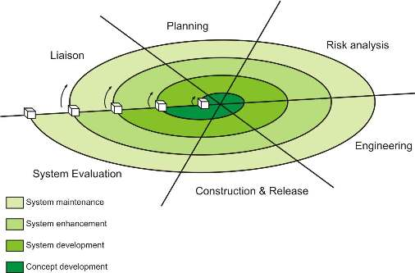
Methodology
Fig. Spiral Model

Slide 6
Spiral Model was proposed by Boehm in 1986.
Spiral Model uses 4th generation languages and development tools.
Spiral model is used when the requirements are known in advance of implementation.
Spiral model is used when the requirements have no unresolved, high-risk implications
Spiral model is more flexible, as we can easily deal with changes.
Due to user involvement, user satisfaction is improved.
Spiral model is very useful for large and critical projects.

Slide 7
Technology
IDE : Android Studio 3.2.0
Programming Language : JAVA
User Interface Design : XML
Back End : SQLite
OCR API : Google Vision

Slide 8
Main Modules
Splash Activity
Standard Calculator Activity
OCR Calculator Activity
OCR Result Activity
History Activity
About Activity

Slide 9
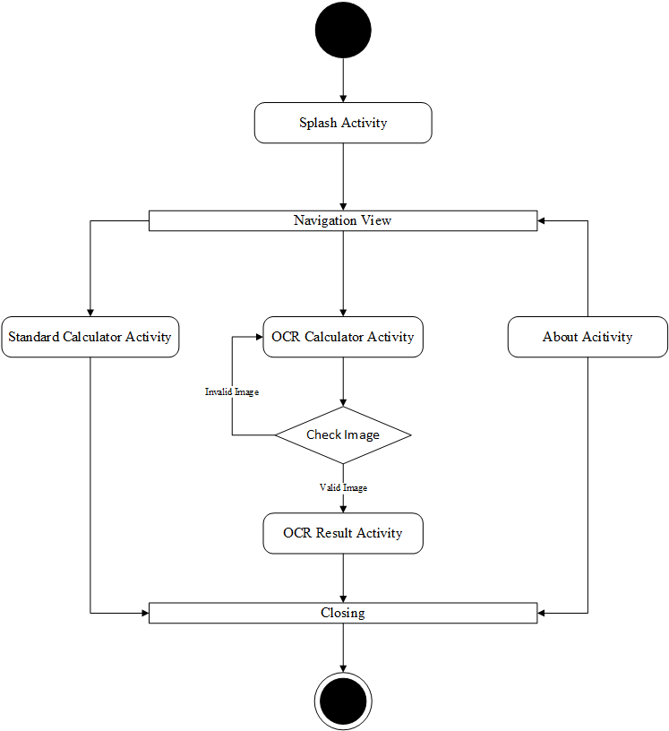
Activity Diagram
Fig. Activity Diagram

Slide 10
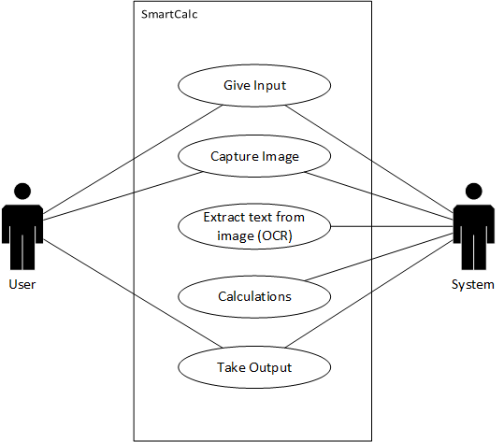
Use Case Diagram
Fig. Use Case Diagram

Slide 11
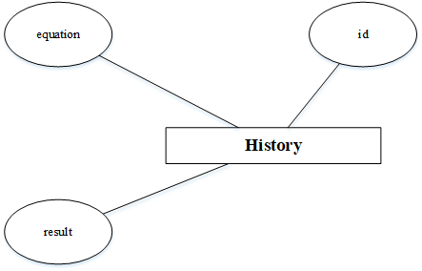
E-R Diagram
Fig. E-R Diagram

Slide 12
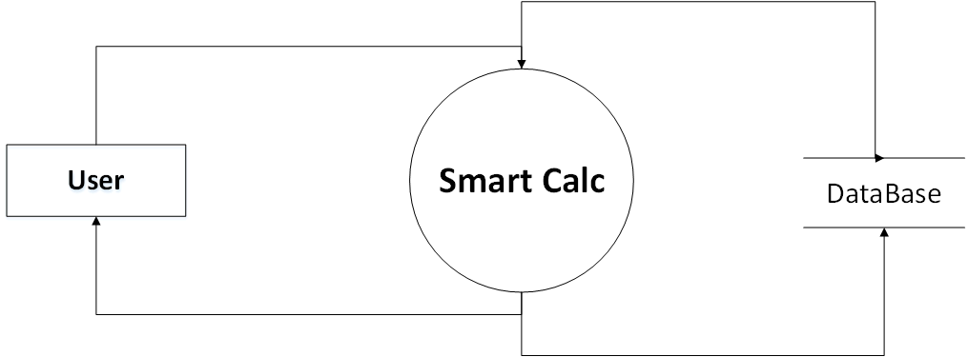
Data Flow Diagram
Context level DFD

Slide 13
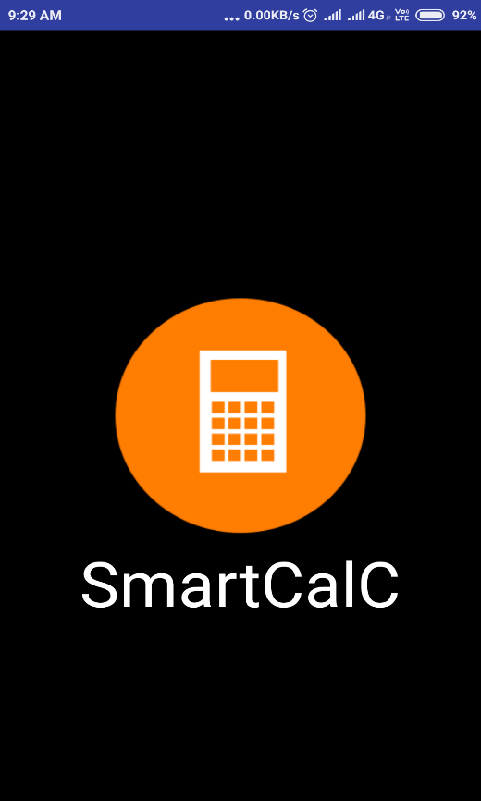
Screen Shots
Splash Activity Screenshot
Fig. Splash Activity

Slide 14
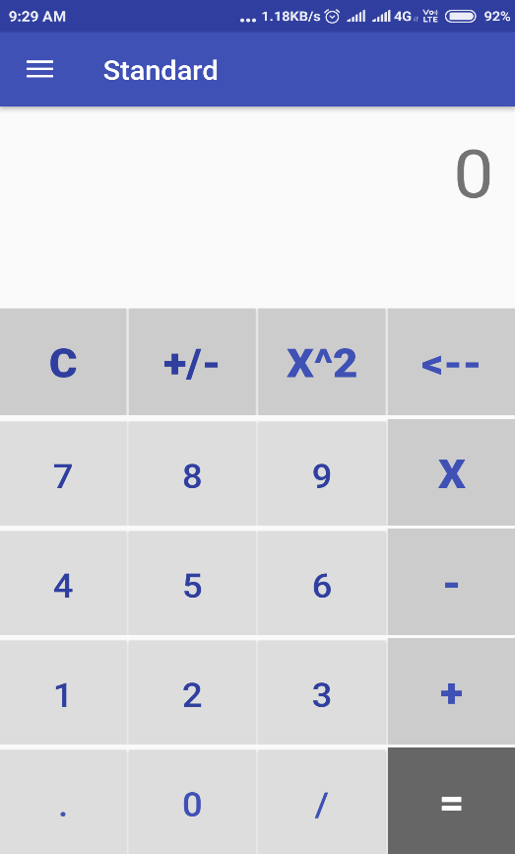
Standard Calculator Activity Screenshot
Fig. Standard Activity

Slide 15
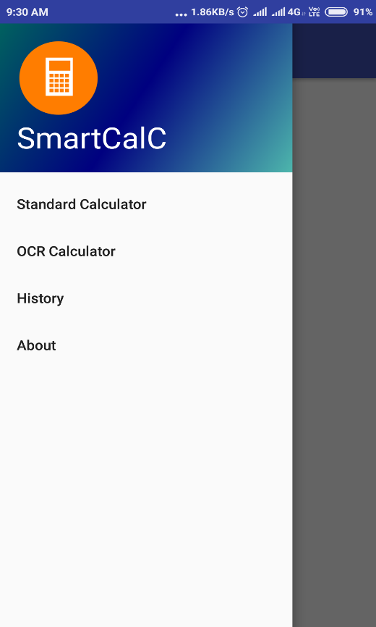
Navigation Viewer Screenshot
Fig. Navigation View

Slide 16
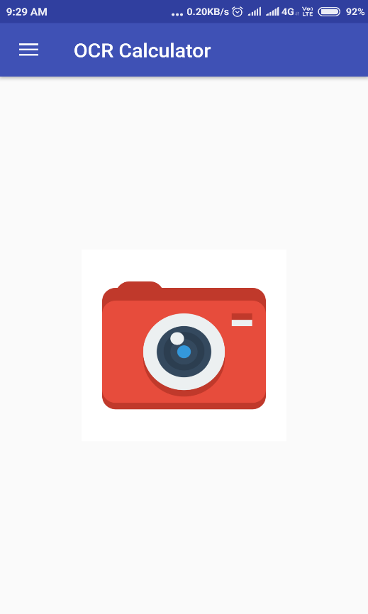
OCR Calculator Activity Screenshot
Fig. OCR Calculator Activity

Slide 17
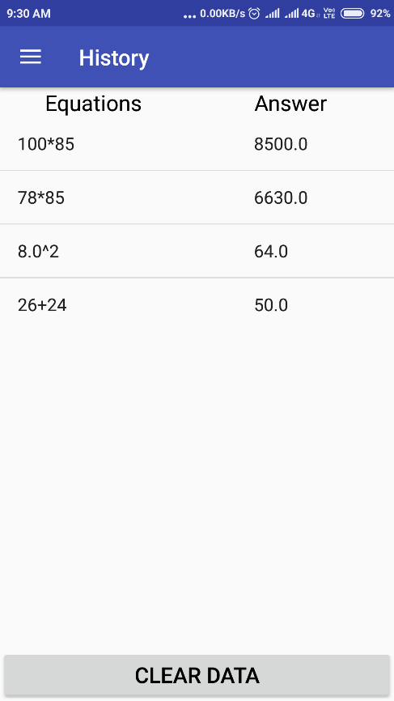
History Activity Screenshot
Fig. History Activity

Slide 18
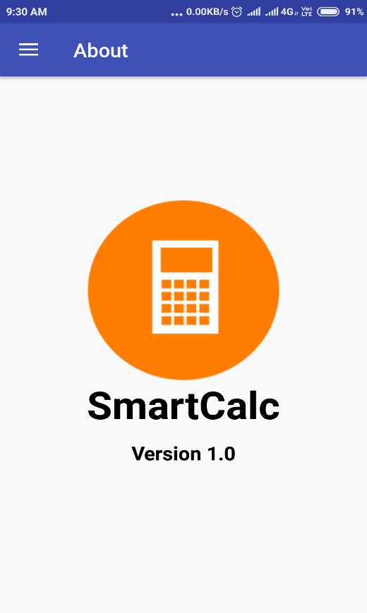
About Activity Screenshot
Fig. About Activity

Slide 19
Conclusion
“SmartCalc” provides the facility to users to calculate the equation without entering data manually.
This application uses Google Vision OCR technology to extract text from an image.
This application makes the calculation faster and accurate.
This application also provides the facility to store the equation and its result.

Slide 20
References
https://en.Wikipedia.org/wiki/Android(Operating_System)
https://docs.oracle.com/javase/tutorial
https://www.sqlite.org/docs.html
https://developers.google.com/vision/android/text-overview

